Slide 1

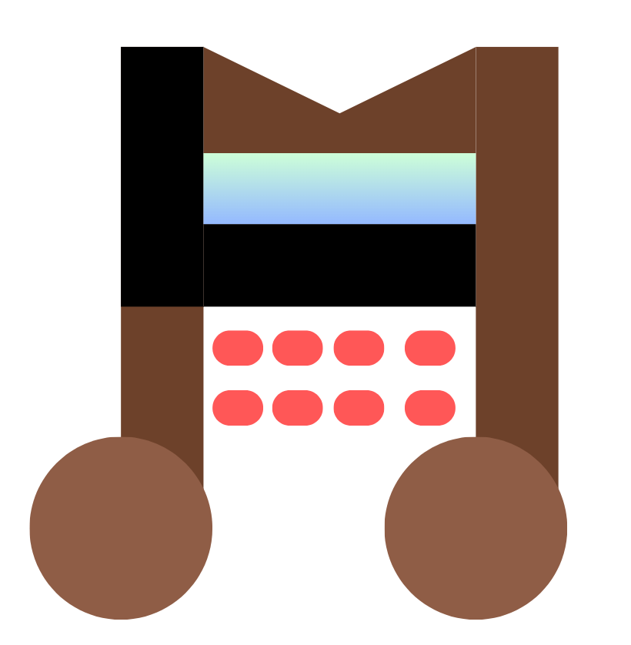
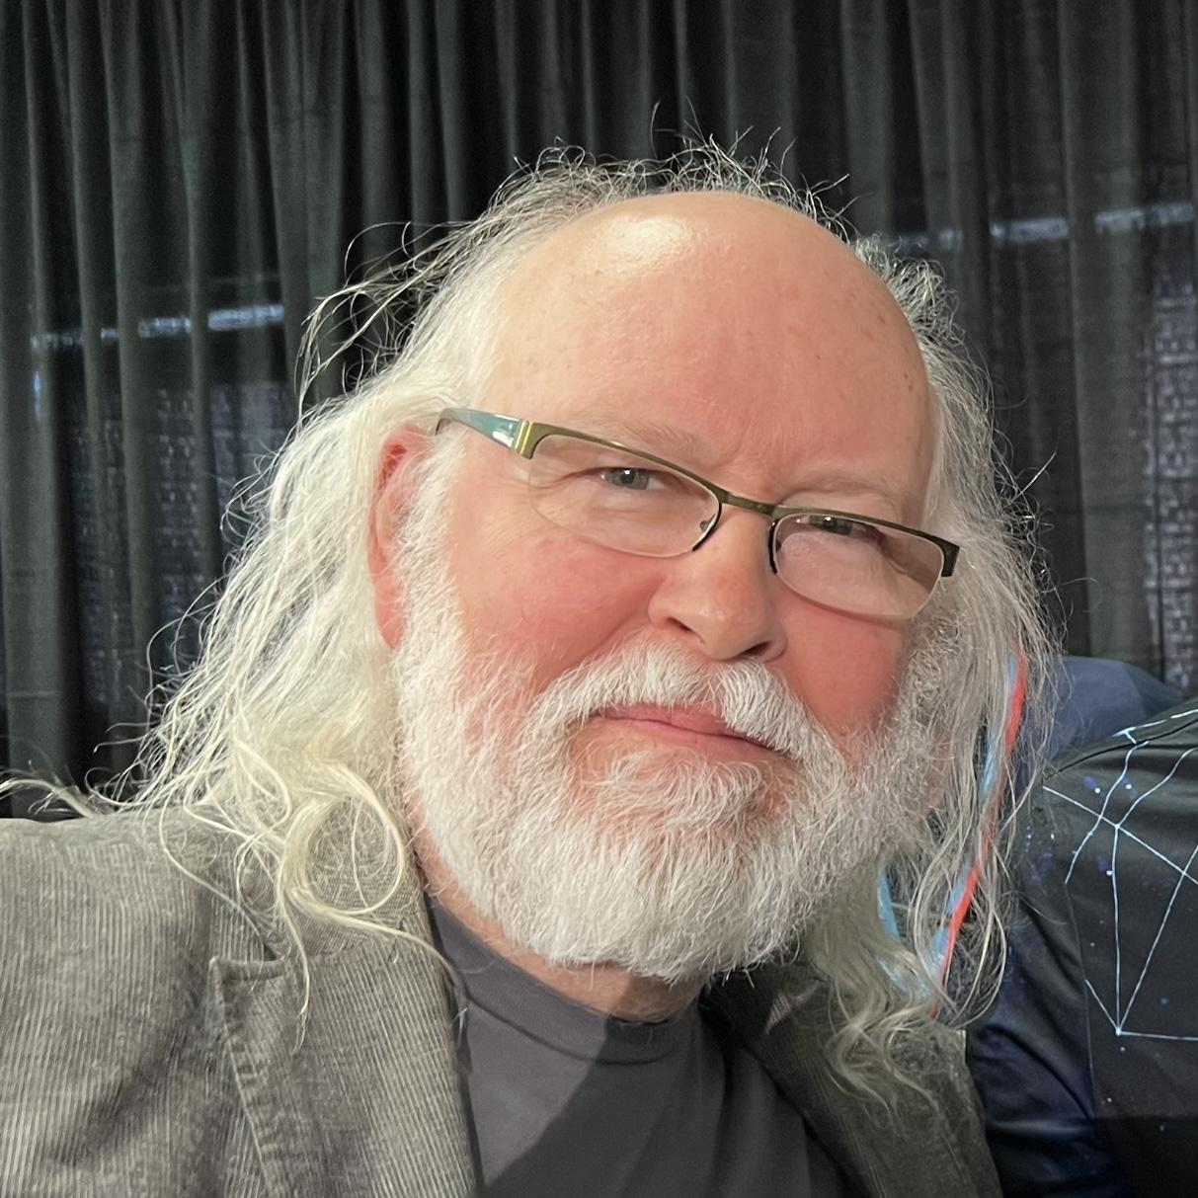

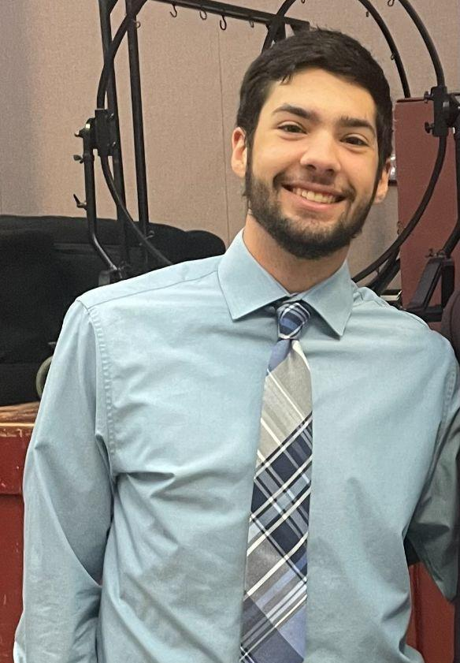


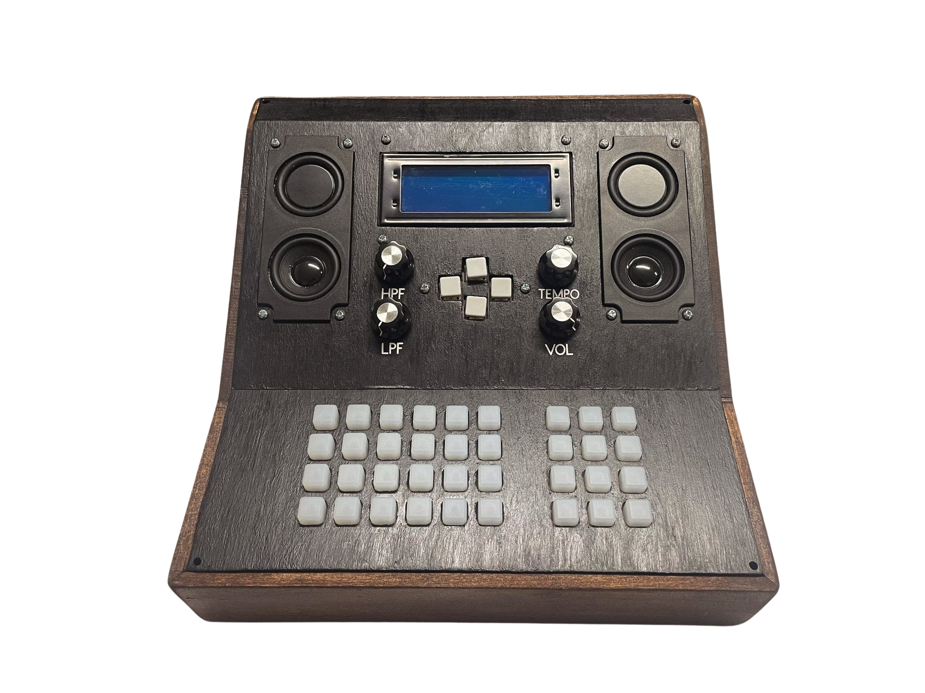
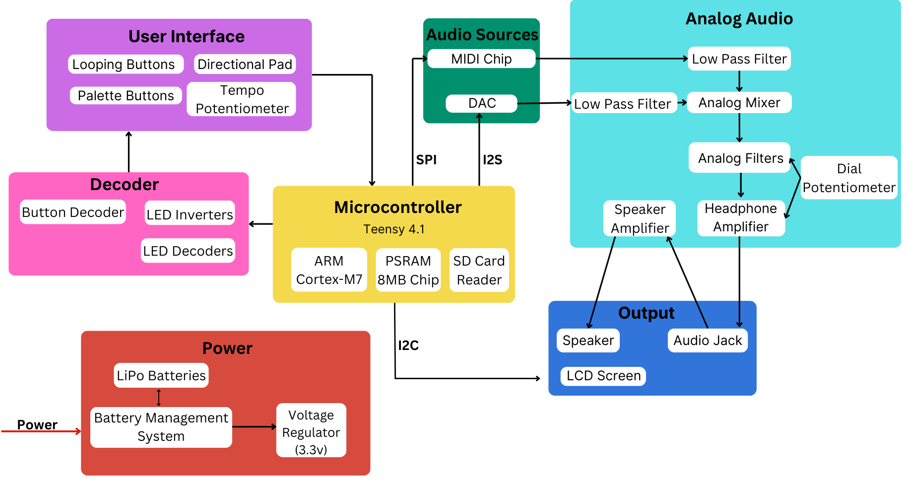

ModuLoop
GitHub:
Conor Curtin, Ryan Gordon,
Evan Rovelli, Shawn Colby
Faculty Advisor: Prof. Baird Soules
Abstract
System Overview
Music creation has evolved over time and a lot of new technology has been incorporated into this process. There are many solutions designed to create backbeats and loops to aid musicians in creating music. However, a lot of these tools only have set features and are quite confusing for an inexperienced user to operate.
We designed an open-source solution that is more modular in its features and easier for that user to operate. Our device can vary the steps and beats in each looping measure, and chain multiple measure together to create longer musical phrases. Our system can play multiple sounds from different sources together and can apply effects to the loops.
ModuLoop contains three main subsystems. One system is the button matrix which detects inputs on the measure matrix and palette. This system also controls the logic of how the LEDs are flashing. The second system is the user interface. This system has a LCD screen which can be navigated through with a directional pad. The menu allows the user to assign sound or effects to the palette, edit the properties of a measure, and save/load tracks. The final system is the analog audio which mixes our two sound sources, runs the audio signal through filters, and outputs the audio to a headphone jack or built-in speaker. The filters are user adjustable with the HPF and LPF knobs on the device. The tempo and volume are also adjustable by the user via knobs.
Hardware Block Diagram
Results
ModuLoop is a music sequencer that makes the user experience easy to learn for less experienced musicians. This device has both a built-in sound library as well as the ability for the user to upload sounds via an SD card. Modular features have been integrated into the measure structure which allows the user to select a specific amount of beats per measure, select a specific amount of steps for each beat, chain multiple measures together, and save user-created tracks. ModuLoop has built-in effects that can be applied to the measure. The final system has a footprint of 9.5in x 9.75in.
Specifications
The system will produce accurate tempo down to the smallest step interval within +/- 2%.
Tempo is adjustable through a user input
High & low pass filters can be applied to final audio mix.
User-interchangeable custom sound files.
GUI used to navigate preset & custom sound libraries and saved pattern configurations.
Preset and custom sounds can be mixed together.
Achieve at least four sounds layered per step.
System outputs to built-in speakers or line out.
System is operable by both rechargeable battery and power supply.
Device under 13 x 13-inch footprint.
Acknowledgement
We would like to thank Professor Anderson and Professor Lorenzo for their influential feedback at various stages of our design. We would like to thank the course TA Qingchuan Wu and Jonah Yolles-Murphy for their assistance in designing and troubleshooting our system. We also would like to thank SDP23 Team 11 for their support early on in our first PCB revision. Last, but certainly not least, we would like to thank our advisor Professor Baird Soules for his amazing guidance and support throughout this past year.
Department of Electrical and Computer Engineering
ECE 415/ECE 416 – SENIOR DESIGN PROJECT 2024
College of Engineering - University of Massachusetts Amherst
SDP24

Slide 2
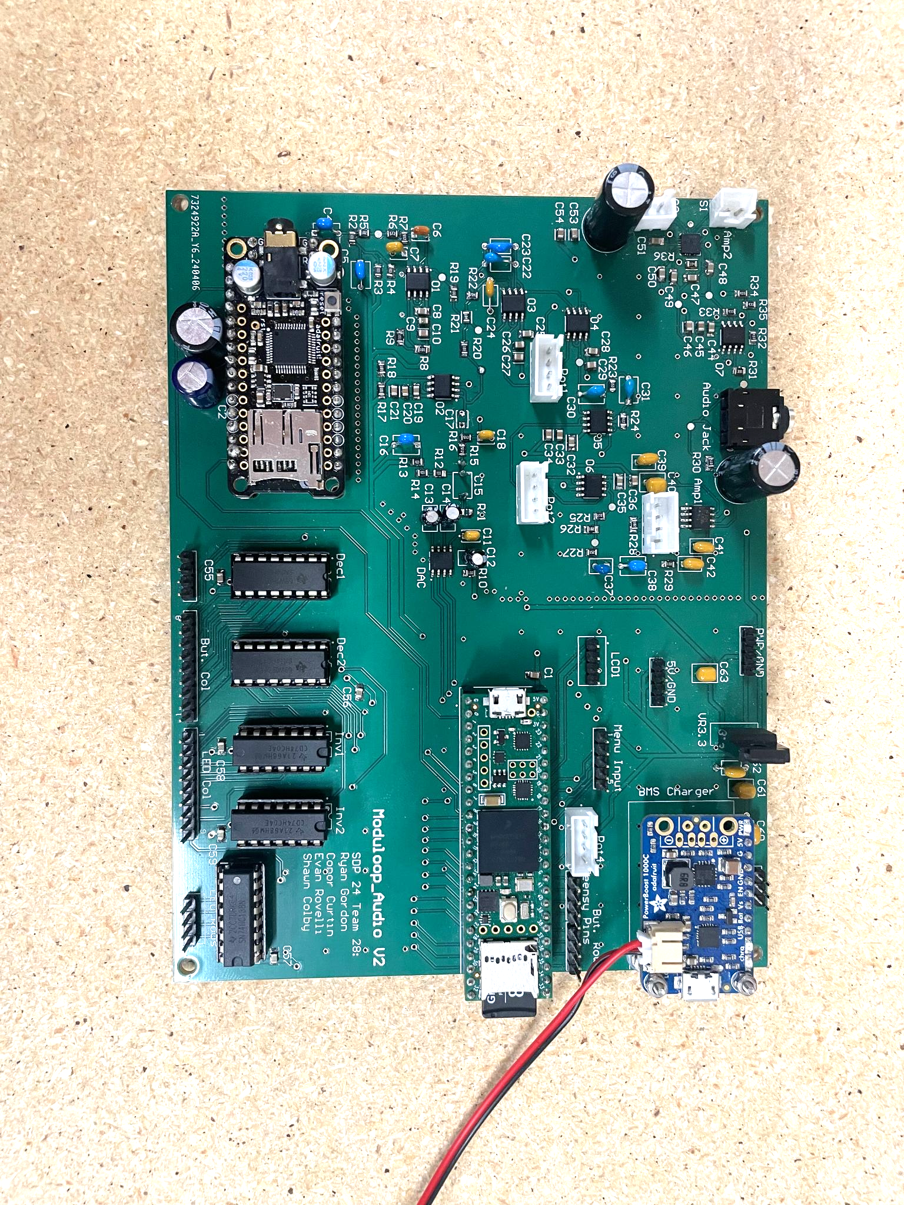
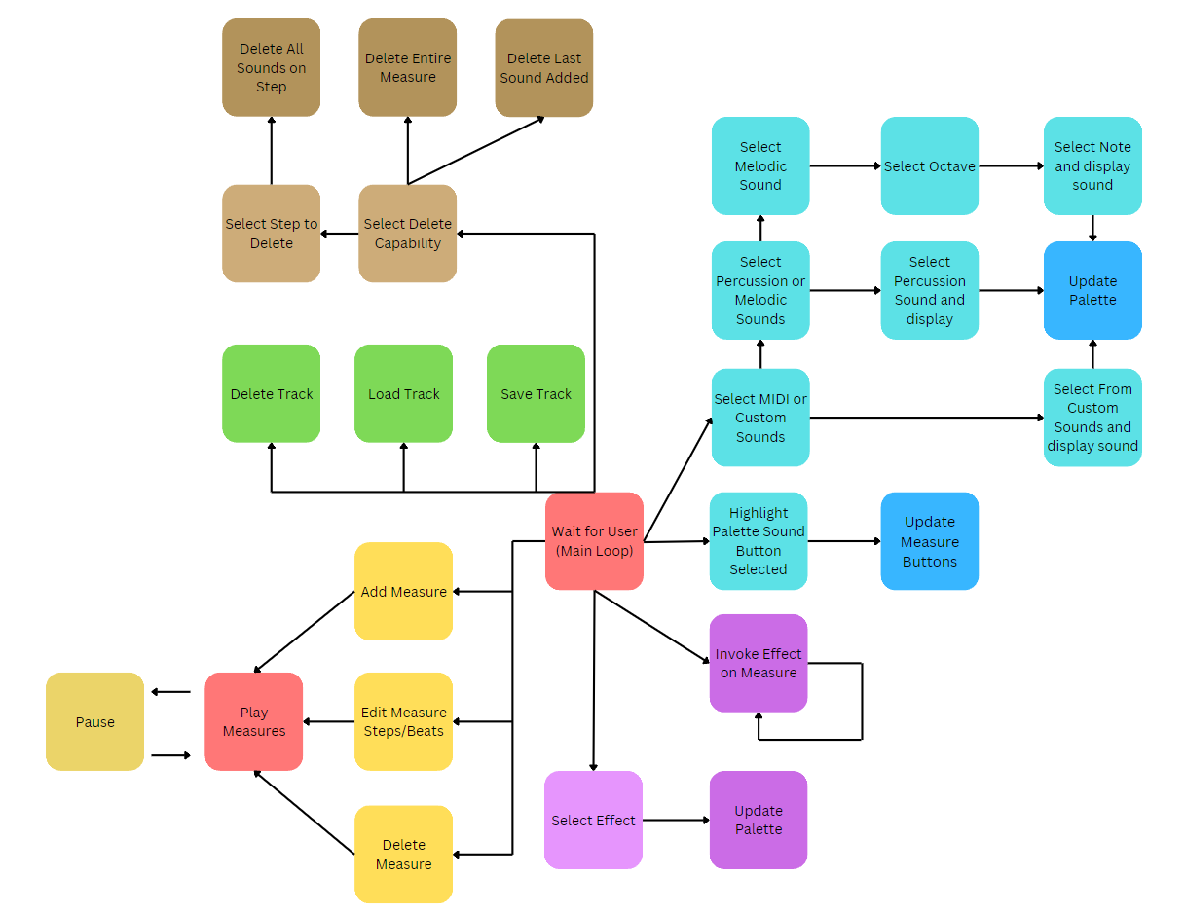
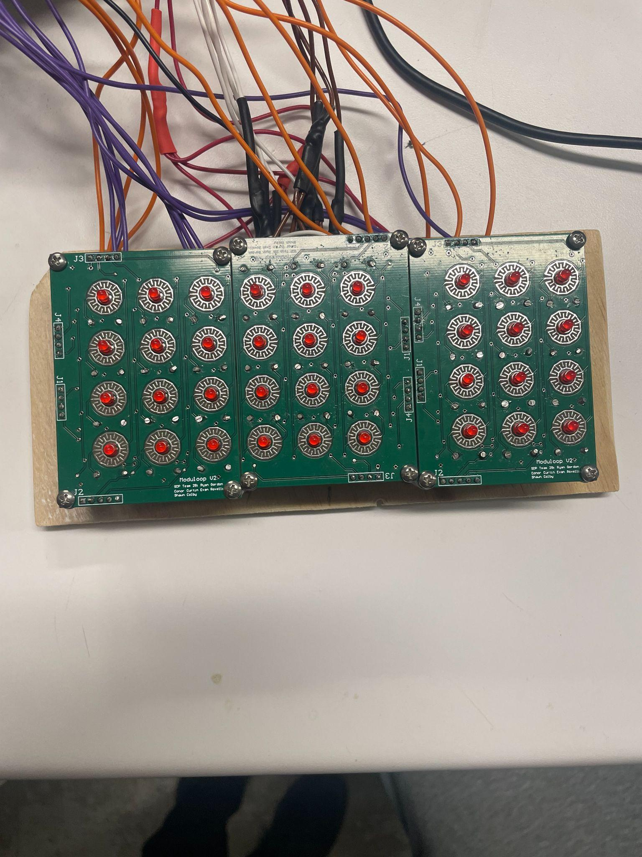
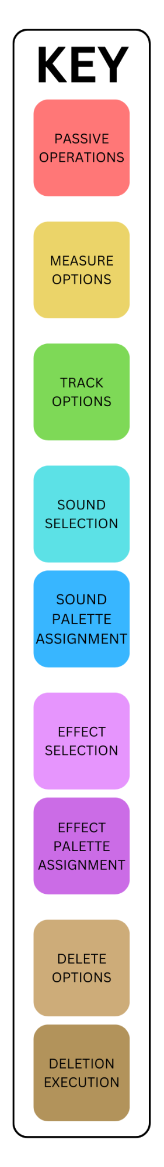
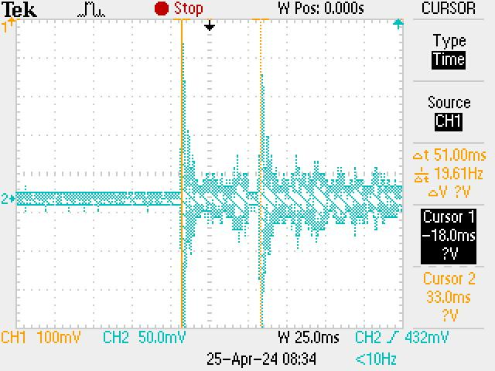
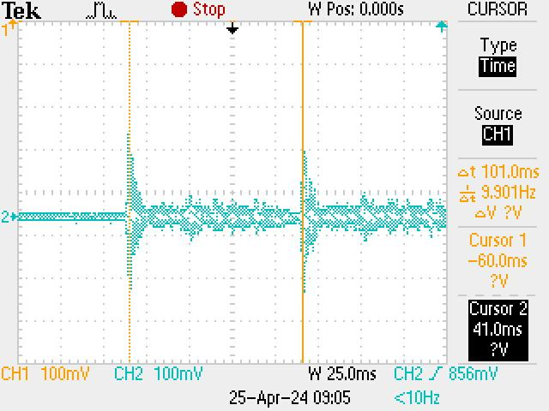
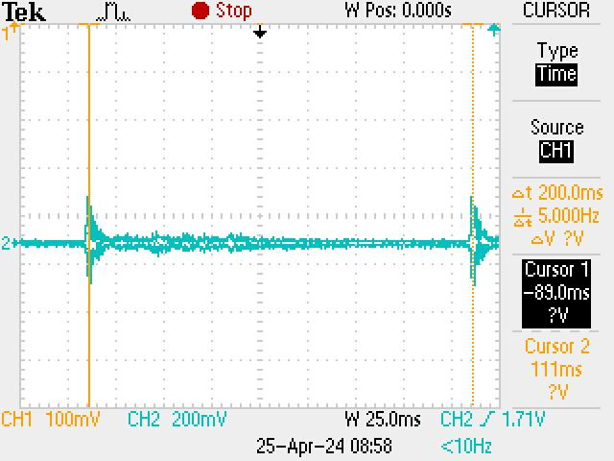
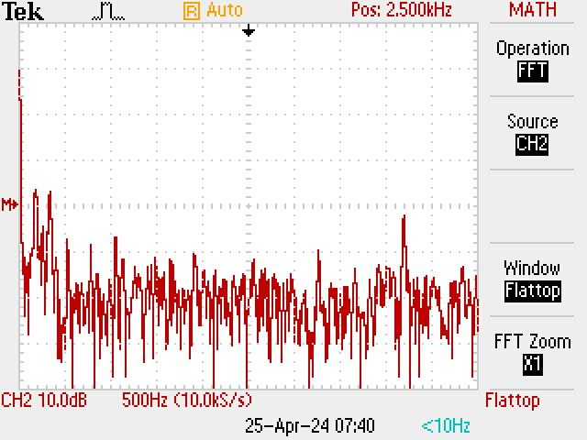
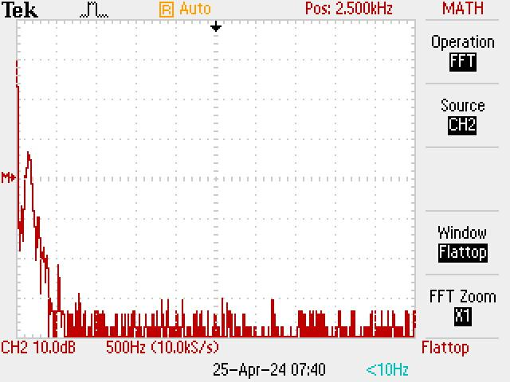
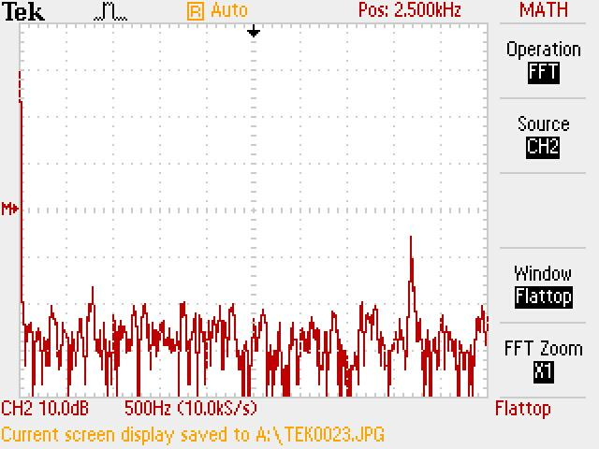
Software Block Diagram
PCB Design
Audio PCB
Passive state performs measure timing and I/O input reading subroutines.
Measure options edit the current track’s measures for chaining and ordering.
Track options: read, write, and delete tracks stored persistently on the onboard SD card.
Sound selection guides the user through preset and custom sound selection on GUI.
Sound palette assignment assigns selected sound to user selected palette button.
Effect selection guides the user through effect selection on GUI.
Effect palette assignment assigns selected effect to user selected palette button.
Delete options are performed on user selected measure, beat, or step.
Delete execution preforms selected deletion option.
Button PCBs
Timing Analysis
Spec: +/- 2% @ 6 Steps / Beat
Theoretical: 200BPM=50ms/beat
Achieved: 196BPM=51ms/beat
Percent difference: 2%
Theoretical: 100BPM=100ms/beat
Achieved: 99BPM=101ms/beat
Percent difference: 1%
Cost
Theoretical: 50BPM=200ms/beat
Achieved: 50BPM=200ms/beat
Percent difference: 0%
Part | Price (USD)
Teensy 4.1 | 31.50
PSRAM 8MB | 1.80
LM386m-1 | 1.49
TPA2016D2 | 2.23
NE5532 | 3.78
10k Potentiometer | 6.08
Music Maker Featherwing | 19.95
3mm Red LEDs | 6.20
1N5818 Diode | 9.58
Silicone Button Pads | 23.16
1206 Resistors | 0.90
Powerboost 1000c | 19.95
0805 Resistors | 0.68
0805 Capacitors | 2.40
Part | Price (USD)
Through-hole Capacitors | 4.37
SN74HC138N Decoders | 3.72
SN74HC04N Inverters | 1.40
BA33JC5 Regulator | 2.57
20x4 LCD | 13.30
Speakers | 10.99
Potentiometer Caps | 8.79
Power Switch | 0.67
Li-Ion Battery | 29.95
12mm Grey Tactile Button | 1.49
Button PCB | 6.54
Audio PCB | 7.96
Total | 224.10
Filter Analysis
Measured using FFT on an oscilloscope w/ demo soundtrack
No Filter
Low Pass Filter
f_{c} = 300 Hz
High Pass Filter
f_{c} = 3 kHz

